Slide 1
Machine Learning with
Class Imbalance
Notes:
I’m going to talk today about a problem frequently encountered in applied machine learning. How do we train machine learning algorithms on data that’s highly imbalance?

Slide 2

Hi, I’m Sushmita!
Data Scientist @ Northwestern Neighborhood & Network Initiative (@N3Initiative)
MA Computational Social Science, University of Chicago (10/10 would recommend)
BA/MA Economics, Indian Institute of Technology Madras
R-Ladies Chicago
@SushGopalan on Twitter
@sushmitavgopalan16 on Github
Notes:
Hi, I’m Sushmita! I’m a Data Scientist now at the Northwestern Neighbourhood and Network Initiatve at Northwestern University. I use spatial and network analysis to examine the ways crime spreads through social and spatial networks. I arrived at data science by way of Economics and policy research and the Computational Social Science programme at Uchicago - would 10/10 recommend. I tweet @SushGopalan, often about television and sometimes about data science.

Slide 3
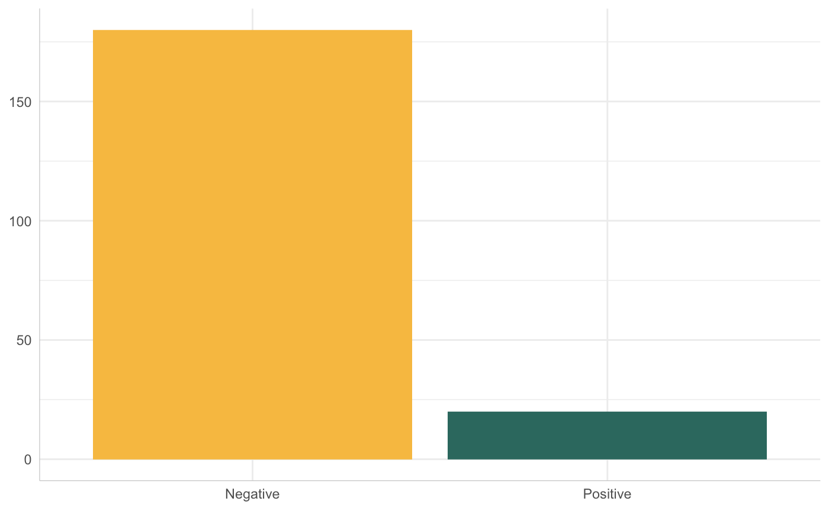
Class Imbalance - the class of interest is much rarer than the other class(es)
Fraud detection
Medical diagnoses
Risk Prediction
Notes:
the term class imbalance describes a situation where the class of interest is much more rare than the other class or classes. A classic example of this is when you’re trying to identify which financial transactions are fraudulent and which ones are legitimate. Obviously, far more transactions tend to be valid and so, we would have a class imbalance issue on our hands.

Slide 4
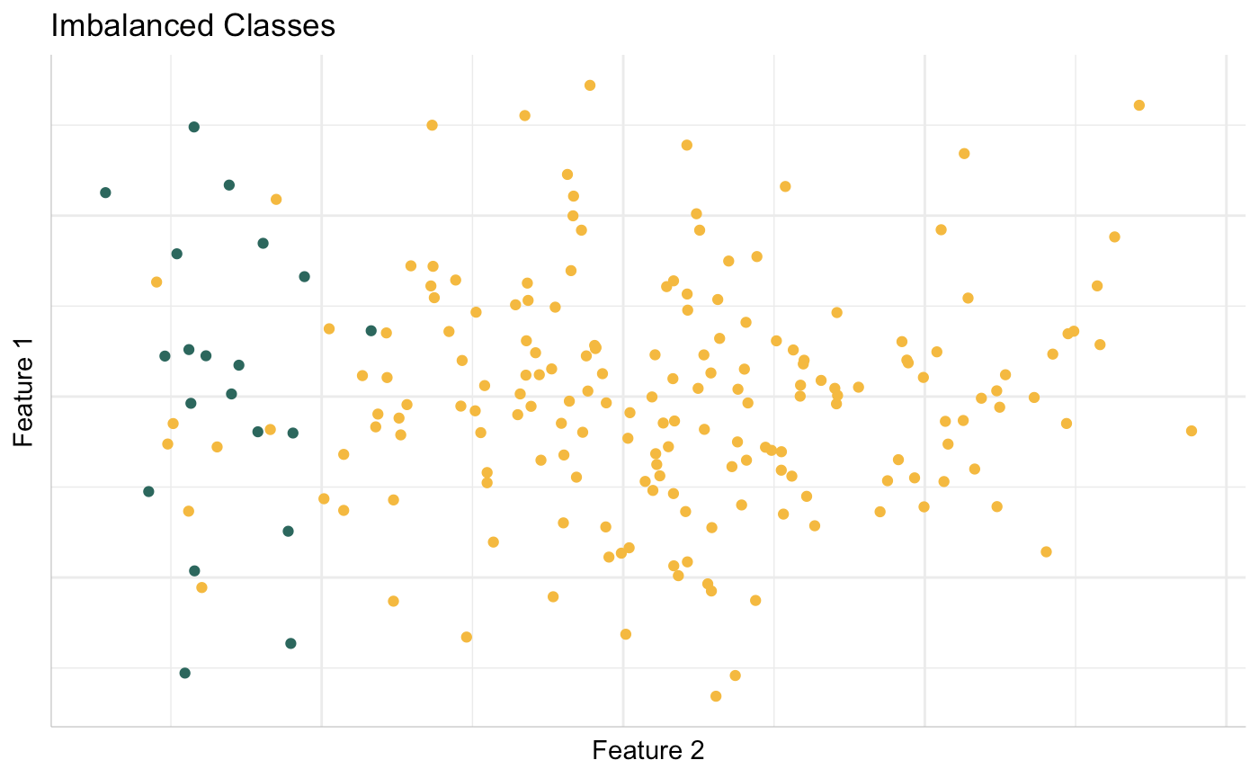
Data from https://github.com/scikit-learn-contrib/imbalanced-learn
Notes:
For the purposes of clarity, I’ll discuss a binary classification example using two features. The yellow dots are the negative examples or the majority class and the green dots are the positive examples or the minority class.

Slide 5
Why is this a problem?

Slide 6
The cost of misclassifying a minority example can be higher.
Failure to identify a fraudulent transaction
Failure to identify an individual as high risk for post-surgical complications
Notes:
The cost of misclassifying a minority example can be higher. Failing to flag a fraudulent transaction where your customer loses 2000 dollars versus sending them a potential misuse alert on their netflix payment. Misclassifying a very sick baby as healthy and sending her home versus giving a healthy pregnant woman free neonatal vitamins.

Slide 7
Most model evaluation metrics assume balanced classes.
Accuracy of 98% ?
Dig deeper
Confusion matrix
Precision
Recall
Notes:
A lot of the model evaluation metrics we commonly use average across classes and assume balance. Accuracy is the most frequently cited metric. If you have 3 positive examples and 97 negative examples, blindly predicting ‘negative’ each time would give us an accuracy of 97% - but does that actually serve our purpose?

Slide 8
Always look at the confusion matrix.
Predicted : Positive
Predicted : Negative
True Positive | False Negative
False Positive | True Negative
Actual : Positive
Actual : Negative
Notes:
We always want to look at measures split up over classes. The confusion matrix is our first line of defense here. Clearly, we want the true positive and true negative rates to be as close to 1 as possible and the false positive and false negative rates to be as close to zero as possible.

Slide 9
True Positives
Precision = ---------------------------------- Total Predicted Positives
What proportion of positive predictions made by the model were actually positive?
Notes:
Precision and Recall are both useful metrics to look at in the presence of class imbalance. Precision measures the proportion of positive predictions made by the model that were actually positive. If our model flagged a 100 transactions as fraud, what percentage of them were _actually_ fraud? How precise are our predictions?

Slide 10
True Positives
Recall = -------------------------------- Total Actual Positives
Of all observations that were actually positive, how many did our model identify as positive?
Notes:
Recall, on the other hand, measures the proportion of actually fraudulent transactions our model flagged as fraud. Of the observations that were actually positive, how many did our model identify as positive?

Slide 11
Blindly predict Positive for everything?
Accuracy = 10%
Precision on minority class = 10%
Recall on minority class = 100%
Notes:
If we were to blindly predict positive for all examples, we would have 100% recall on the minority class, but only 10% precision and 10% accuracy.
If we were to blindly predict negative, we would have an accuracy of 90% but a 0% recall on the minority class.
These measures are class-specific and generalize easily to multiclass classification
Remember that these measures are class-specific and generalize easily to multi-class classification.

Slide 12
Blindly predict Positive for everything?
Accuracy = 10%
Precision on minority class = 10%
Recall on minority class = 100%
Blindly predict Negative for everything?
Accuracy = 90%
Precision on minority class = NA
Recall on minority class = 0%
Notes:
If we were to blindly predict positive for all examples, we would have 100% recall on the minority class, but only 10% precision and 10% accuracy.
If we were to blindly predict negative, we would have an accuracy of 90% but a 0% recall on the minority class.
These measures are class-specific and generalize easily to multiclass classification
Remember that these measures are class-specific and generalize easily to multi-class classification.

Slide 13
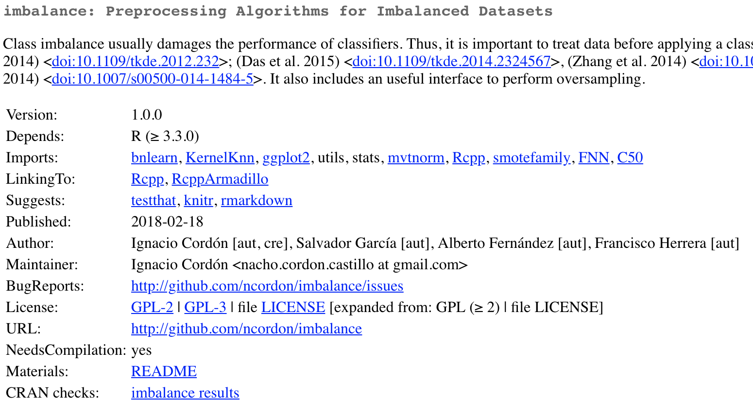
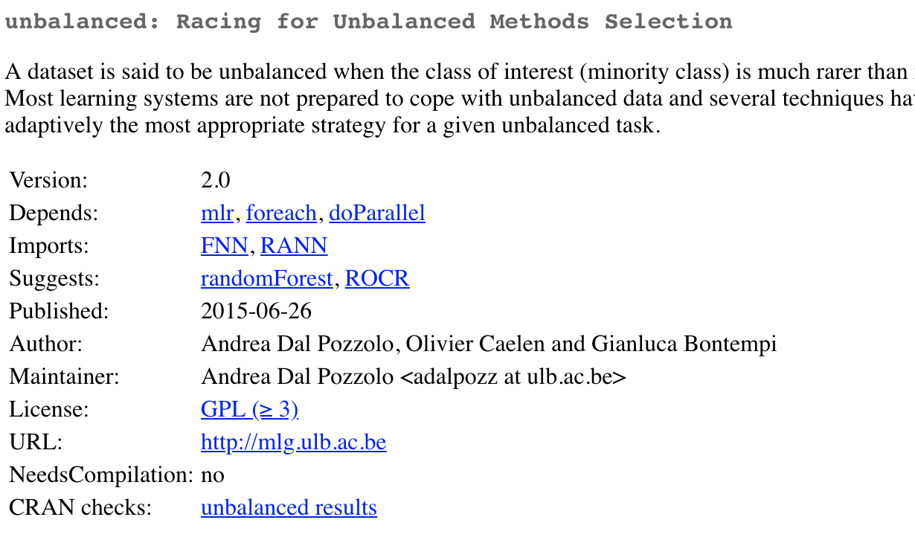
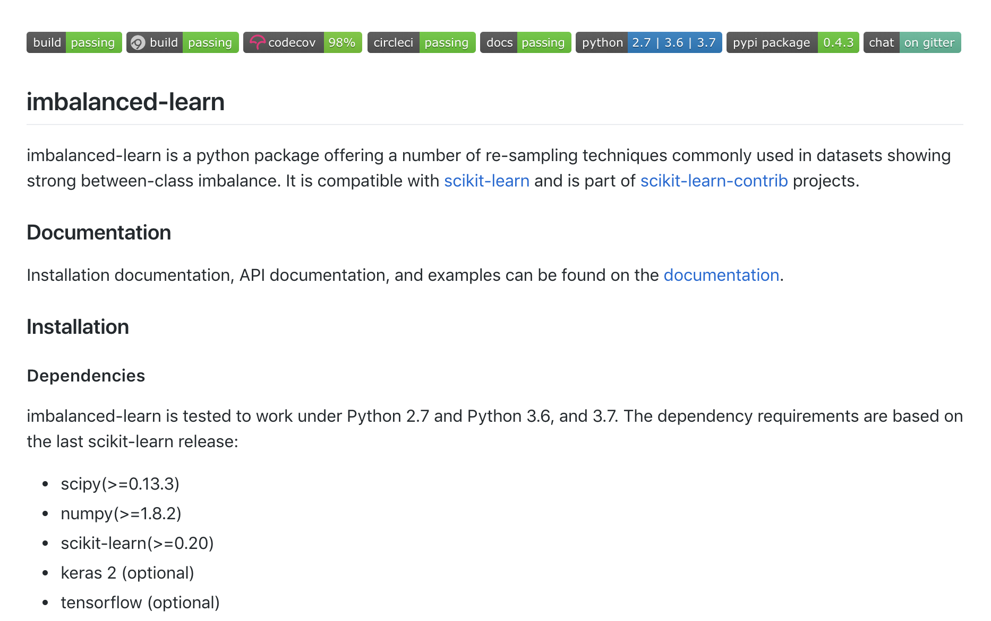
Notes:
There are a couple of packages on CRAN which have tidy-friendly implementations of some methods to address the imbalance issue. They’re conveniently named imbalance and unbalanced. I’ll be showing you examples from the unbalanced package today. For Python users, there’s imbalanced-learn which plays nicely with scikit-learn.

Slide 14
What can you do?
‘Data Mining’ Solutions
Machine Learning Solutions
Cost sensitive learning
Ensemble methods
Notes:
So, what can you do when faced with a class imbalance problem? Obviously before you start, ensure that the scarcity of positive examples is not a data collection or measurement issue. Once you’ve done that there, you want to take a two pronged approach.
Use the data you have to extract more information. Resample it, pare it down, generate some more data.
Figure out what learning algorithms will serve your purpose best. . One approach is cost sensitive learning. You use a customized loss function to levy a harsher penalty on your classifier when it misclassifies a minority class example.
Ensemble methods always help, especially in conjunction with multiple rounds of resampling. Averaging your predictions across multiple base classifiers will reduce your variance further.
I’ll talk mostly about data mining solutions today, but I will talk briefly about algorithmic modifications and then walk you through a quick case study.

Slide 15
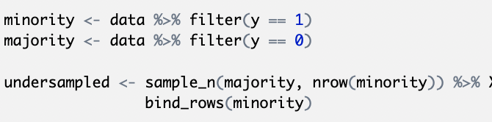
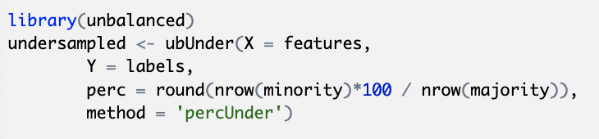
Random Undersampling
Notes:
The first approach is random undersampling. Here, you just use a random subset of the majority class examples so that the resulting dataset is balanced. You can use the ubUnder function from the unbalanced package, or you can just do it in two lines of tidy code

Slide 16
Throwing away good data
Decision boundary changes with chosen subset
Cross-validate
Notes:
Obviously, there are drawbacks to this. We’re discarding a large volume of ‘perfectly good’ data. As you can see, the decision boundary would change depending on which subset you happen to draw. Cross-validating across multiple random draws could alleviate this issue to some extent.

Slide 17
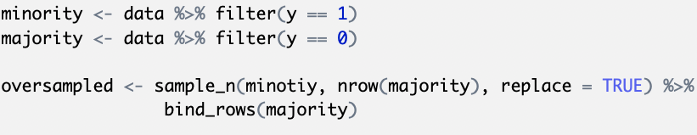
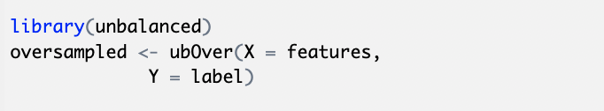
Random Oversampling
Notes:
The next approach is random oversampling where you just sample with replacement from the minority class until you have a balanced dataset.

Slide 18
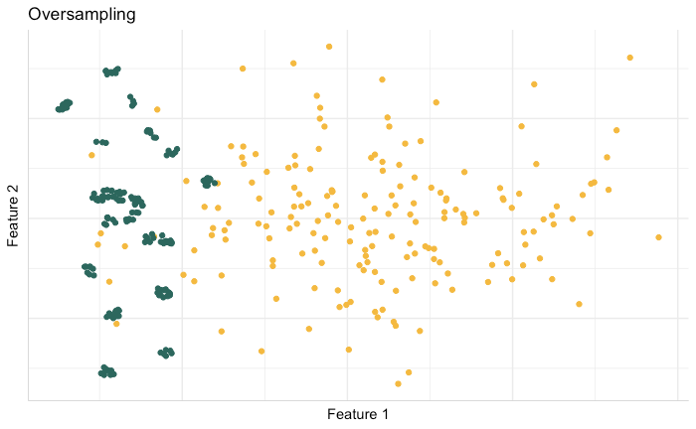
Equivalent to re-weighting (with a little randomness)
More data ≠more information
Undue emphasis on outliers
Risk of overfitting
Notes:
Random oversampling is a lot like weighting examples based on inverse class frequency, except that the random sampling introduces some variability in which example gets duplicated more often. This does help the classifier make slightly better decision rules about the minority class because it’s ‘encountering’ more positive examples. However, more data isn’t necessarily more information and we could end up overfitting to these duplicated points. There’s also the risk that outliers will get duplicated a lot and exert undue influence on the decision boundary.

Slide 19
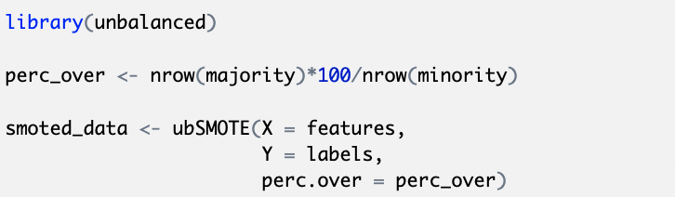
Synthetic Minority Oversampling Technique (SMOTE)
Chawla, Nitesh V, Kevin W Bowyer, Lawrence O Hall, and W Philip Kegelmeyer, “SMOTE: synthetic minority over-sampling technique,” Journal of Artificial Intelligence Research, 2002, 16, 321–357.
Notes:
The next option is the Synthetic Minority Oversampling Technique or SMOTE, proposed by Nitesh Chawla and his collaborators in the Journal of Artifical Intelligence Research in 2002. What this does is create new synthetic minority examples through interpolation. Each new point is a weighted average of existing points. You can vary the number of different points used to create each new point.

Slide 20
New data points through interpolation
Less overfitting
New points lie within same convex space
Notes:
Watch how this happens. It’s easier to observe in two dimensional space with two features. It literally just picks two points, draws a line between them and plops down a new point somewhere along that line.
Unlike random oversampling, this is less likely to lead to overfitting because these are actual new points.

Slide 21
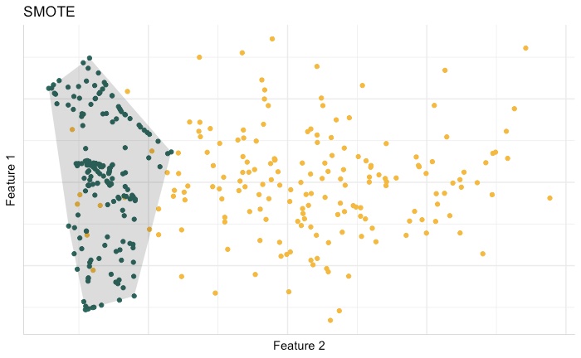
Notes:
However, all the new points lie within the same convex feature space as the original points. If the features on your original points capture the range of values that testing examples could take, SMOTED data can help your classifier ‘get to know’ the minority data a lot better.

Slide 22
Removing TOMEK Links
Disambiguate class boundaries
A pair of observations forms a TOMEK link if
They are each other’s nearest neighbour and
They have different class labels
Tomek, Ivan, “Two modifications of CNN,” IEEE Trans. Systems, Man and Cybernetics, 1976, 6, 769–772.
Notes:
The next approach is an attempt to disambiguate class boundaries. We want to create more distinct boundaries between the classes so the classifier’s view of the minority examples is not occluded by the presence of majority examples.
A pair of observations forms a TOMEK link if
They are each right next to each other and have different class labels

Slide 23
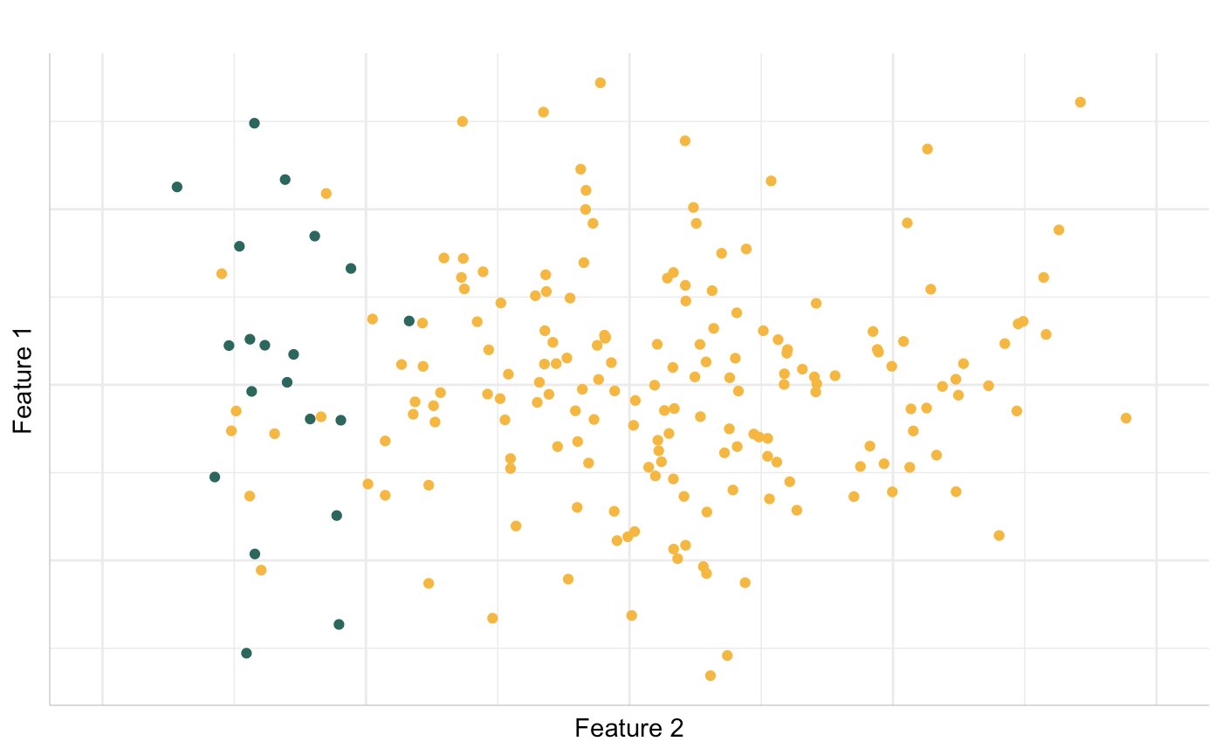
Removes noisy borderline examples
Works best in conjunction with some oversampling / adaptive learning algorithms
Notes:
As you can see, these are three Tomek Links. We throw out the yellow part of each of these tomek pairs, thus clarifying the boundary between the green and yellow dots. Removing tomek links has had great results in combination with some oversampling and adaptive learning algorithms

Slide 24
Predicting Infant Mortality:
Minimizing False Negatives
Notes:
I’m going to walk you through a short application, which I used as part of my MA thesis at UChicago.

Slide 25
32 out of 1,000 babies born in India die within a year
Can we identify pregnant mothers at risk for infant death?
Some predictive variables -
Mother’s age
Time since previous birth
Anaemia
Notes:
In 2015, the infant mortality rate in India was 32 out of 1000 babies dying within one year of their birth.
Interventions at the time of pregnancy for high-risk mothers have been shown to lower the risk of complications.
These interventions, however, are expensive. Can we focus this intervention on high-risk mothers and identify them using machine learning? Some variables that are predictive of infant death within a year are the mother’s age, the time since her her previous delivery and anaemia the time of pregnancy.

Slide 26
92.7 % accuracy from vanilla logistic regression
However, I was misclassifying 3 out of 4 high-risk pregnancies as safe!
Focus on minimizing False Negatives?
What are the trade-offs?
Class Imbalance Ratio - 93:7
Notes:
Once I had gathered the variables suggested by the literature, I ran a vanilla logistic regression and found an accuracy of 92.7%. I thought I was kind of a genius!
I poked a little bit and found that I was misclassifying 3 out of 4 high-risk pregnancies as safe! I knew I needed to minimize false negatives - i.e., reduce the number of high-risk mothers being tagged as healthy. I also needed to keep the false positive rate low enough that the focused targeting of high-risk mothers was actually economically feasible. Less than 7% of the data I had was on mothers who lost their babies within a year.

Slide 27
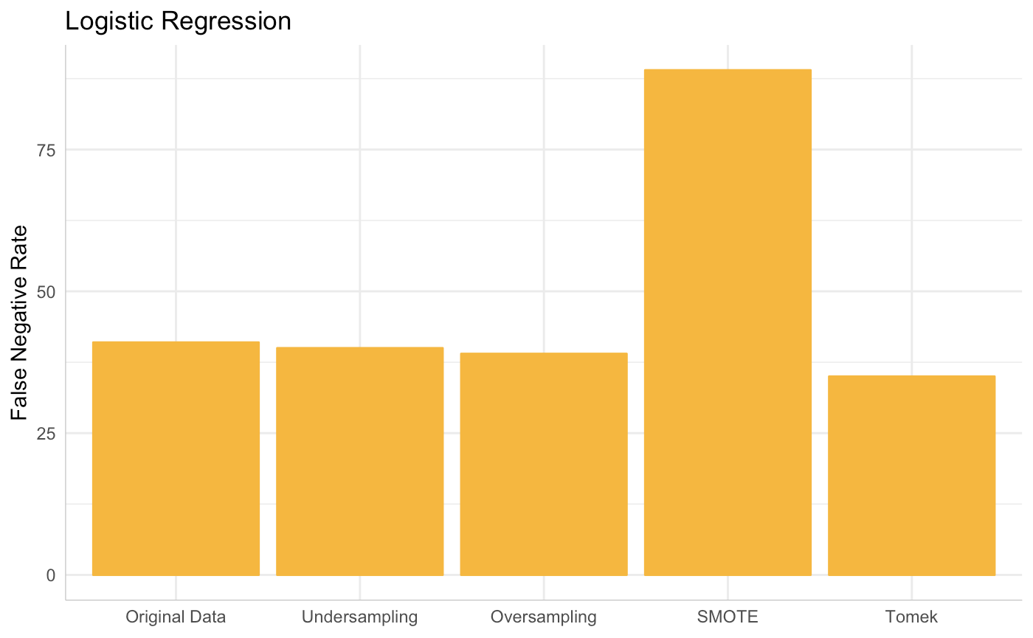
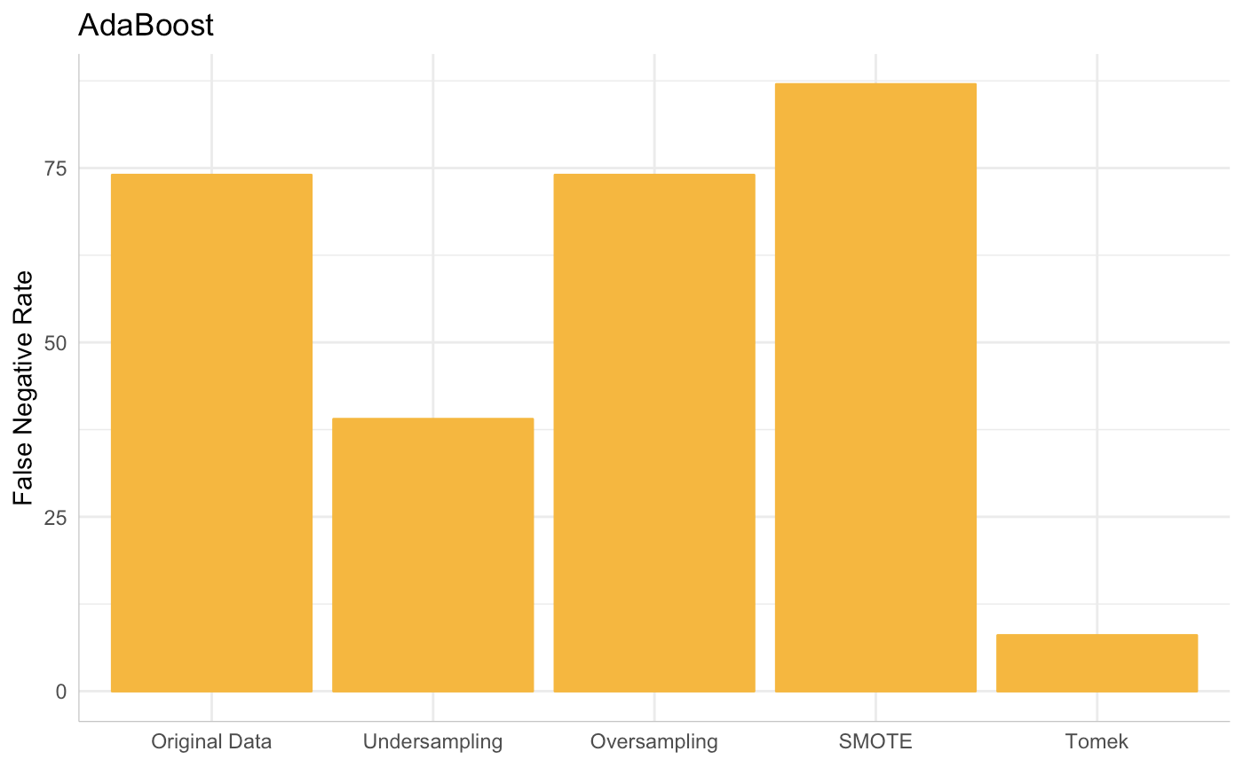
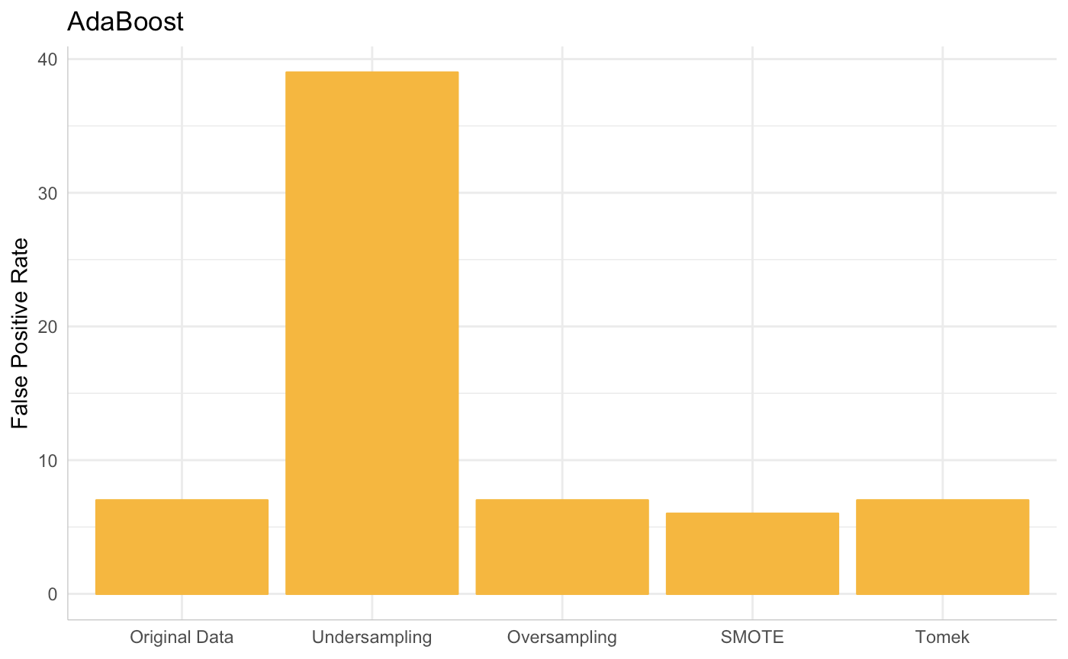
Notes:
I tried all the resampling techniques I showed you today with several learning algorithms. Here I have my baseline logistic regression and the method that worked best - the AdaBoost algorithm on data from which Tomek links had been removed. As you can see my false negative rate falls to 6% with this combination and my false positive rate stays low enough at 8%.

Slide 28
Why did removing Tomek Links + AdaBoost work best for THIS data, given THESE objectives?
Discarded only 0.2% of the data
Robust to cross-validation
Sick babies that survive can look very similar to sick babies that do not
Notes:
What combination of resampling and learning works really depends on the data you have. Tomek links and AdaBoost worked in this context for a couple of reasons. Only 0.2% of the data had to be discarded.
Primarily, I believe it makes sense with my data because sick babies that survive can look very similar to sick babies that do not based on my feature set. A number of factors that I did not have knowledge of - such as the mother’s tenacity / the weather / living next door to a midwife etc. could be the reason for two identical sick babies having different outcomes.
Removing sick babies that survive from the sample prevents the classifier from thinking that’s what a healthy baby looks like.

Slide 29
How do you choose a strategy?
Know the structure of your data
Evaluate your trade-offs
Trial-and-error

Slide 30
Thank you!

